Slide 1
ECE 471/571 – Lecture 23
Support Vector Machine
11/24/14

Slide 2
Reference: Christopher J.C. Burges, “A tutorial on support vector machines for pattern recognition,” Data Mining and Knowledge Discovery, 2, 121-167, 1998

Slide 3
A bit about Vapnik
Started SVM study in late 70s
Fully developed in late 90s
While at AT&T lab
http://en.wikipedia.org/wiki/Vladimir_Vapnik
Notes:
Currently at NEC, NAE member

Slide 4
Generalization and Capacity
For a given learning task, with a given finite amount of training data, the best generalization performance will be achieved if the right balance is struck between the accuracy attained on that particular training set, and the “capacity” of the machine
Capacity – the ability of the machine to learn any training set without error
  Too much capacity - overfitting

Slide 5

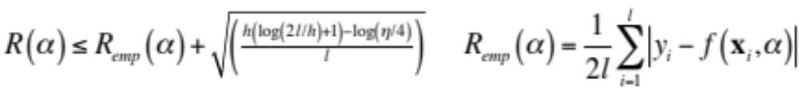
Bounds on the Balance
Under what circumstances, and how quickly, the mean of some empirical quantity converges uniformly, as the number of data point increases, to the true mean
True mean error (or actual risk)
One of the bounds
f(x,α): a machine that defines a set of mappings, x→f(x,α)
α: parameter or model learned
h: VC dimension that measures the capacity. non-negative integer
R_{emp}: empirical risk
η: 1-η is confidence about the loss, η is between [0, 1]
l: number of observations, y_{i}: label, {+1, -1}, x_{i} is n-D vector
Principled method: choose a learning machine that minimizes the RHS with a sufficiently small η

Slide 6
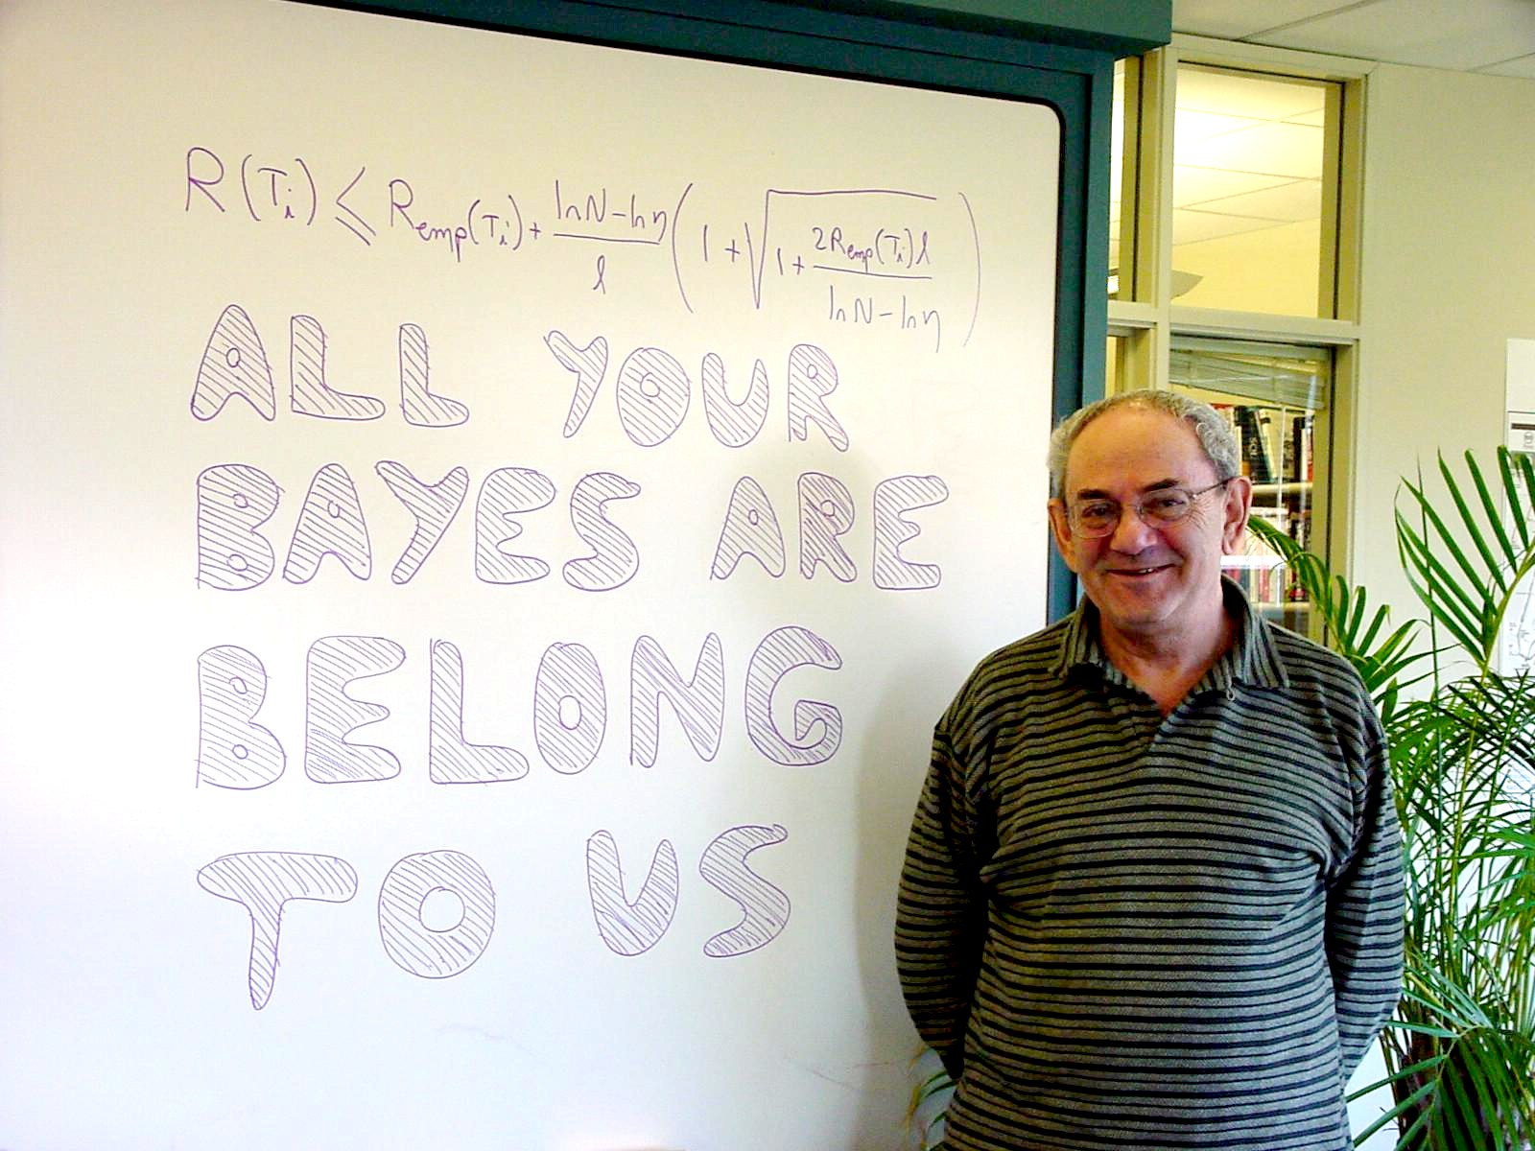

Slide 7
VC Dimension
For a given set of l points, there can be 2^{l} ways to label them. For each labeling, if a member of the set {f(α)} can be found that correctly classifies them, we say that set of points is shattered by that set of functions.
VC dimension of that set of functions {f(α)} is defined as the maximum number of training points that can be shattered by {f(α)}
We should minimize h in order to minimize the bound

Slide 8
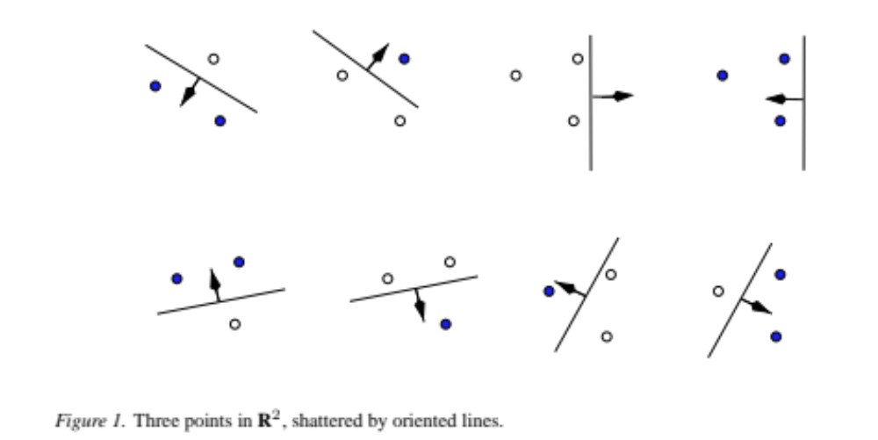
Example (f(α) is perceptron)
Notes:
For all cases of 3-point labels, perceptron can always 100% classify them. Therefore, h=3
As if the number of points is 4, for the case of XOR, it cannot 100% classify them.
The maximum number of points shattered by the classifier.

Slide 9
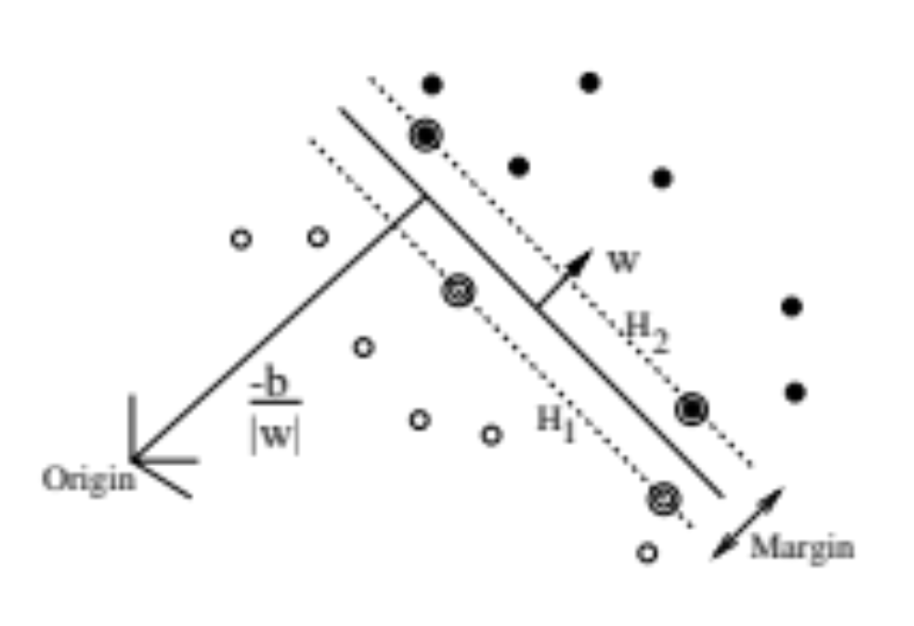


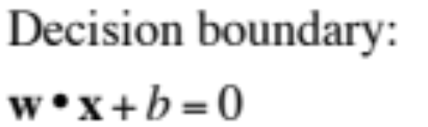
Linear SVM – The Separable Case
Support
vectors

Slide 10
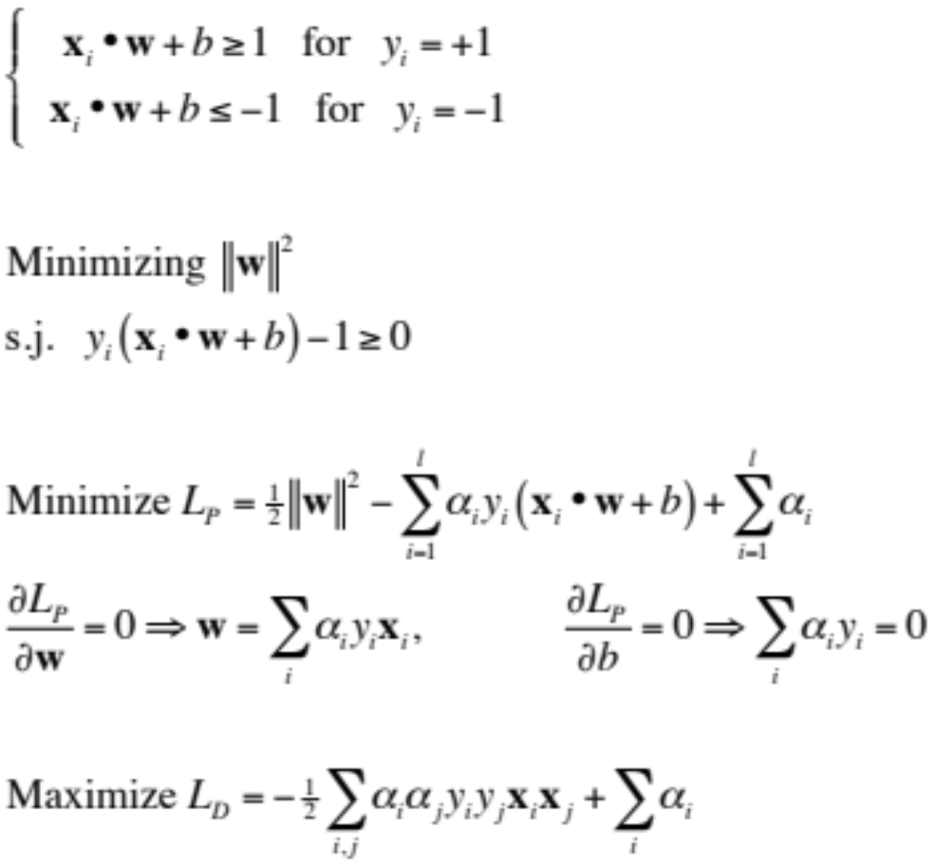

Slide 11
Non-separable Cases
SVM with soft margin
Kernel trick

Slide 12
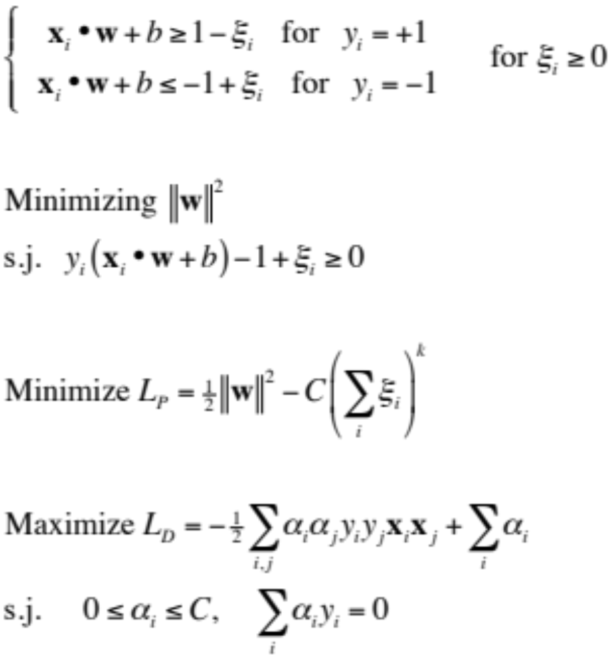
Non-separable Case – Soft Margin

Slide 13
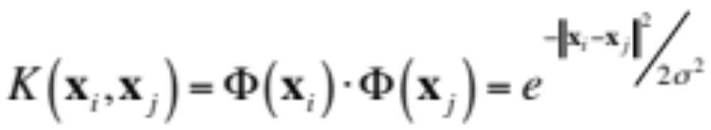
Non-separable Cases – Kernel Trick
If there were a “kernel function”, K, s.t.
Gaussian Radial Basis Function (RBF)

Slide 14
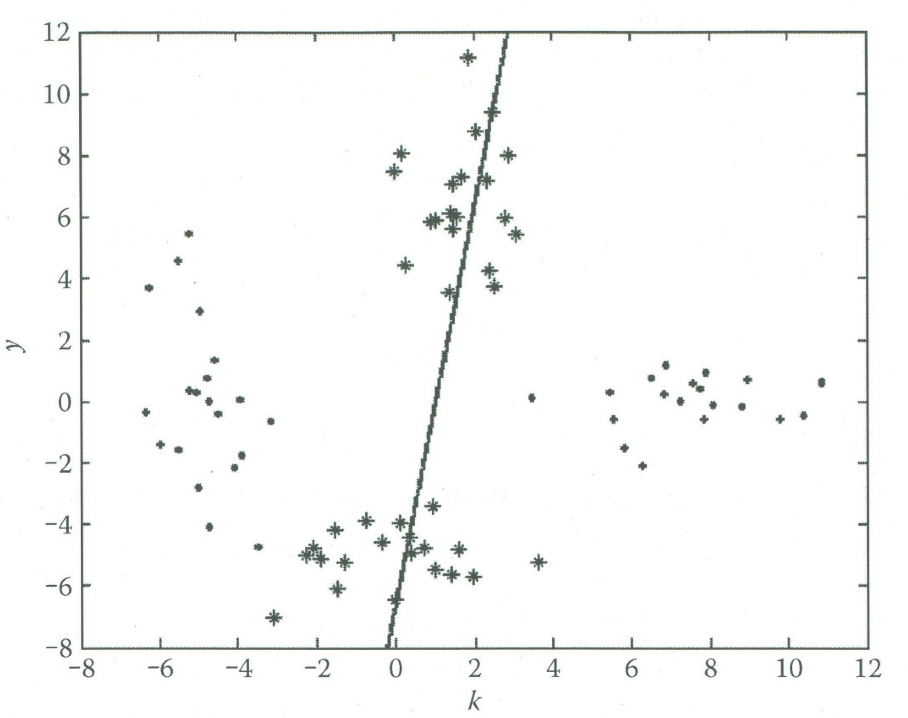
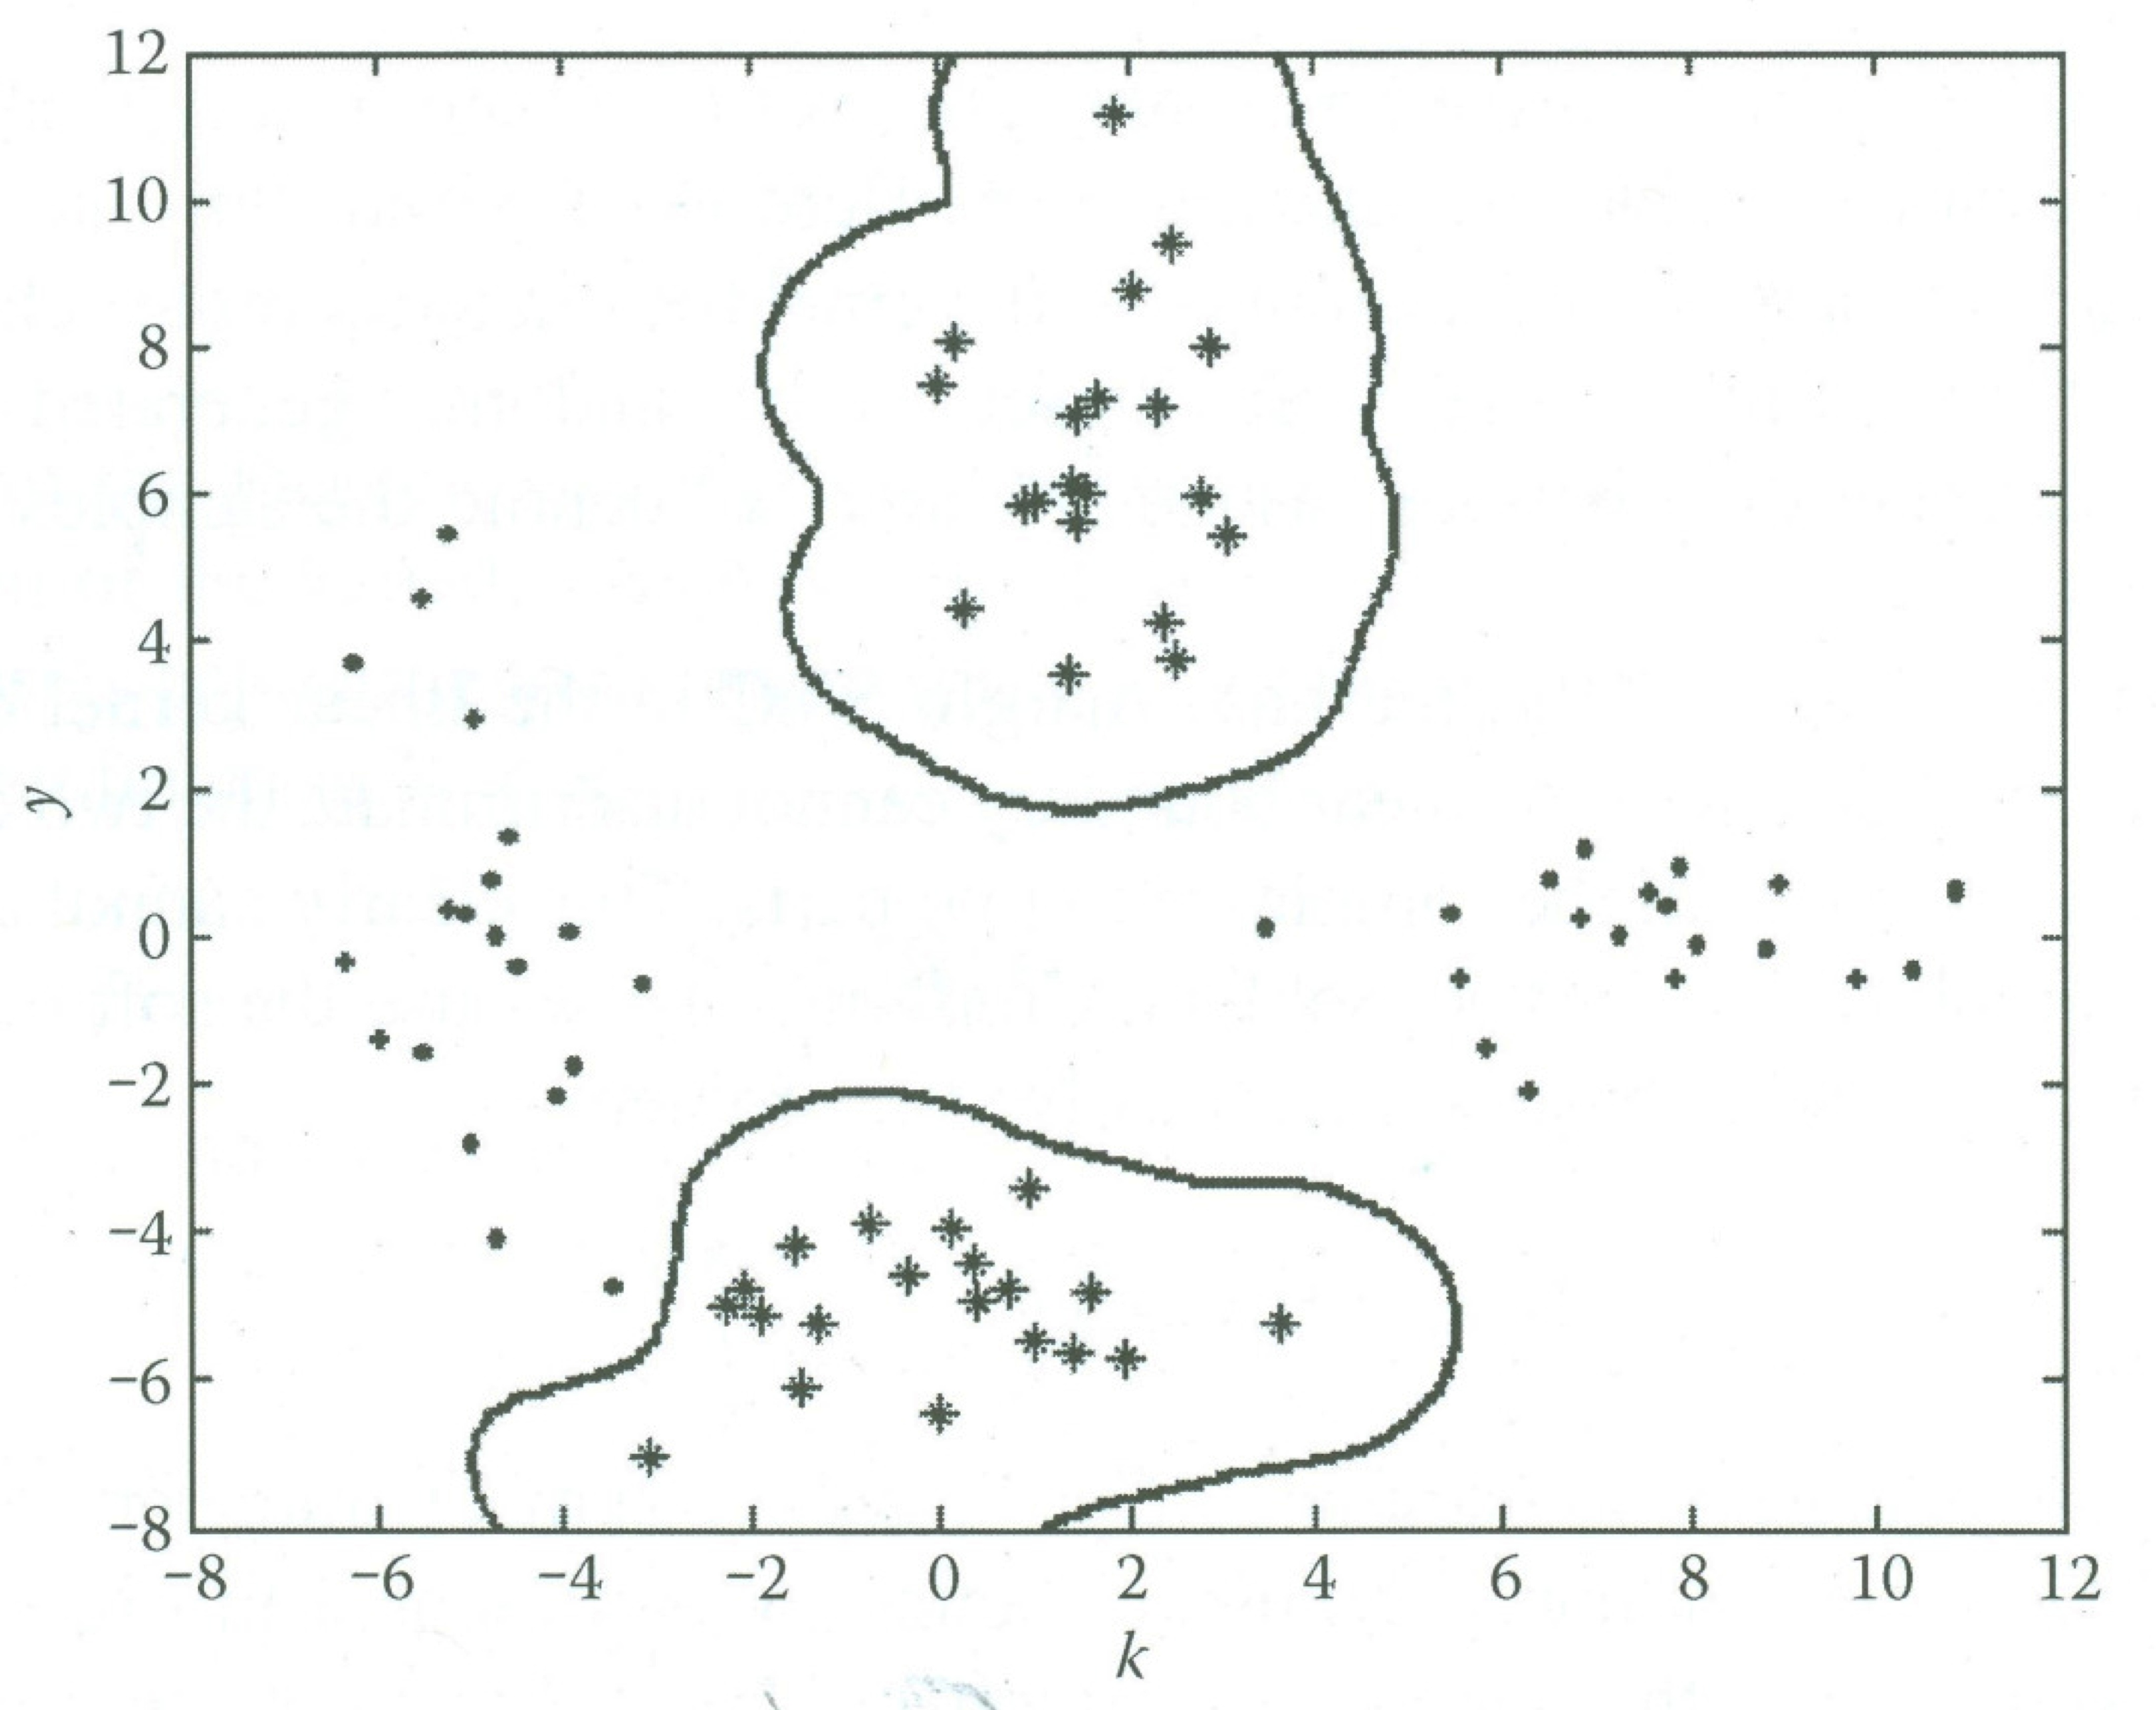
Comparison - XOR

Slide 15
Limitation
Need to choose parameters

Slide 16
Packages
libSVM
  Use one-against-one (1a)
SVM^{light}

Slide 17
Package Installation
Download: http://www.csie.ntu.edu.tw/~cjlin/libsvm/
Installation (Three choices)
  On Unix systems, type `make' to build the `svm-train' and `svm-predict‘ programs.
  On other systems, consult `Makefile' to build them
  Use the pre-built binaries (Windows binaries are in the directory ‘windows').
  More details pls refer to the README file

Slide 18
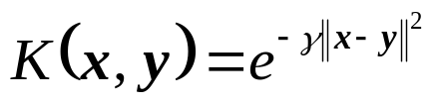


Steps
Step 1: Transform the data to the format of an SVM package
Step 2: Conduct simple scaling on the data
Step 3: Consider the RBF kernel
Step 4: Select the best parameter and to train the whole training set
Step 5: Test

Slide 19




Example
Dataset: pima.tr and pima.te
Step 1: Transform the data to the format of an SVM package
  (training data: every row is a feature vector)
  (testing data: every row is a feature vector)
  (label vector for training data pima.tr)
  (label vector for testing data pima.te)

Slide 20
Example
Step 2: Data scaling
  Avoid attributes in greater numeric ranges dominating those in smaller numeric ranges
  Avoid numerical difficulties during the calculation
How?
  Calculate the min and max for every feature from the training dataset
  For every feature (train or test) f, the scaled feature fs can be calculated by fs = (f-min)/(max-min)
Details pls refer to: http://www.csie.ntu.edu.tw/~cjlin/libsvm/faq.html#f407
http://www.csie.ntu.edu.tw/~cjlin/papers/guide/guide.pdf

Slide 21
Example
Step 3: Train SVM on given parameters
model = svmtrain(ltr, sparse(pima_trs), '-c 16 , -g 0.1');
Label vector for training dataset
Parameter for the kernel function RBF
Trained model
Penalty parameter
1, Pima_trs is the matrix for the scaled features of training dataset
2, Sparse(pima_trs) is an operation to generate a sparse matrix in matlab, required by the libsvm package

Slide 22
Example
Step 4: Test on the trained model
[predict_labels, accuracy, dec_values] = svmpredict(lte, sparse(pima_tes), model);
The predicted labels for testing dataset
Decision values used to classification
Label vector for testing dataset
Trained model
Recognition accuracy for the testing dataset
1, Pima_tes is the matrix for the scaled features of testing dataset
2, Sparse(pima_tes) is an operation to generate a sparse matrix in matlab, required by the libsvm package

Slide 23
Example
Result:
  Scaled:
    Accuracy = 80.1205% (266/332)
  Non-scaled:
    Accuracy = 66.8675% (222/332)

Slide 24
Matlab Code
% Demonstration of the usage of libSVM on pima data set
% Jiajia Luo
clear all;
clc;
% add the path
addpath('E:\My Code\SourceCodeInternet\libsvm-3.1\windows');
% Step 1: Collect the training and testing dataset
fid = fopen('pima.tr.txt');
tr = textscan(fid,'%f %f %f %f %f %f %f %s','HeaderLines',1);
fclose(fid);
fid = fopen('pima.te.txt');
te = textscan(fid,'%f %f %f %f %f %f %f %s','HeaderLines',1);
fclose(fid);
% Step 2: Generate the feature vectors and labels for tr and te
pima_tr = [tr{1} tr{2} tr{3} tr{4} tr{5} tr{6} tr{7}];
pima_te = [te{1} te{2} te{3} te{4} te{5} te{6} te{7}];
Ntr = size(pima_tr,1);
Nte = size(pima_te,1);
ltr = [tr{8}];
lte = [te{8}];
label_tr = zeros(Ntr,1);
label_te = zeros(Nte,1);
for i = 1:Ntr
if strcmp(ltr{i},'Yes')
label_tr(i,1) = 1;
elseif strcmp(ltr{i},'No')
label_tr(i,1) = 2;
end
end

Slide 25
for i = 1:Nte
if strcmp(lte{i},'Yes')
label_te(i,1) = 1;
elseif strcmp(lte{i},'No')
label_te(i,1) = 2;
end
end
% Step 3: scale the data
pima_trs = (pima_tr - repmat(min(pima_tr,[],1),size(pima_tr,1),1))*...
spdiags(1./(max(pima_tr,[],1)-min(pima_tr,[],1))',0,size(pima_tr,2),size(pima_tr,2));
pima_tes = (pima_te - repmat(min(pima_tr,[],1),size(pima_te,1),1))*...
spdiags(1./(max(pima_tr,[],1)-min(pima_tr,[],1))',0,size(pima_te,2),size(pima_te,2));
% Step 4: train the data
model = svmtrain(label_tr, sparse(pima_trs), '-c 16 -g 0.1');
% Step 5: test the data
[predict_labels, accuracy, dec_value_s] = svmpredict(label_te, sparse(pima_tes), model);
% Step 6: Evaluate the performance of using unscaled data
model = svmtrain(label_tr, sparse(pima_tr), '-c 2 -g 0.1');
[predict_label, accuracy, dec_value] = svmpredict(label_te, sparse(pima_te), model);

